Slide 1

Predicting Peak Electricity Usage to Reduce Energy Costs
Aishwarya Sukumaran
Student id: 22058088
as23adl@herts.ac.uk

Slide 2
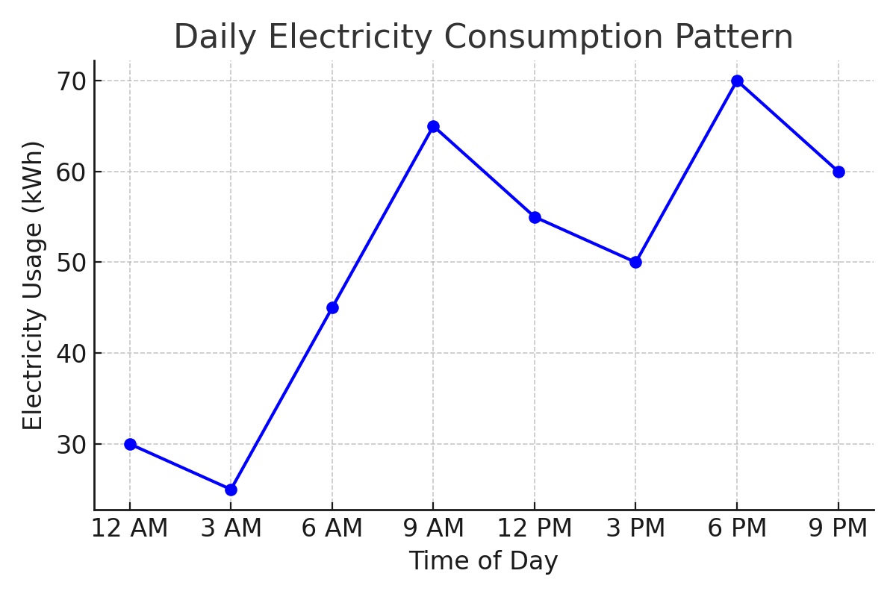
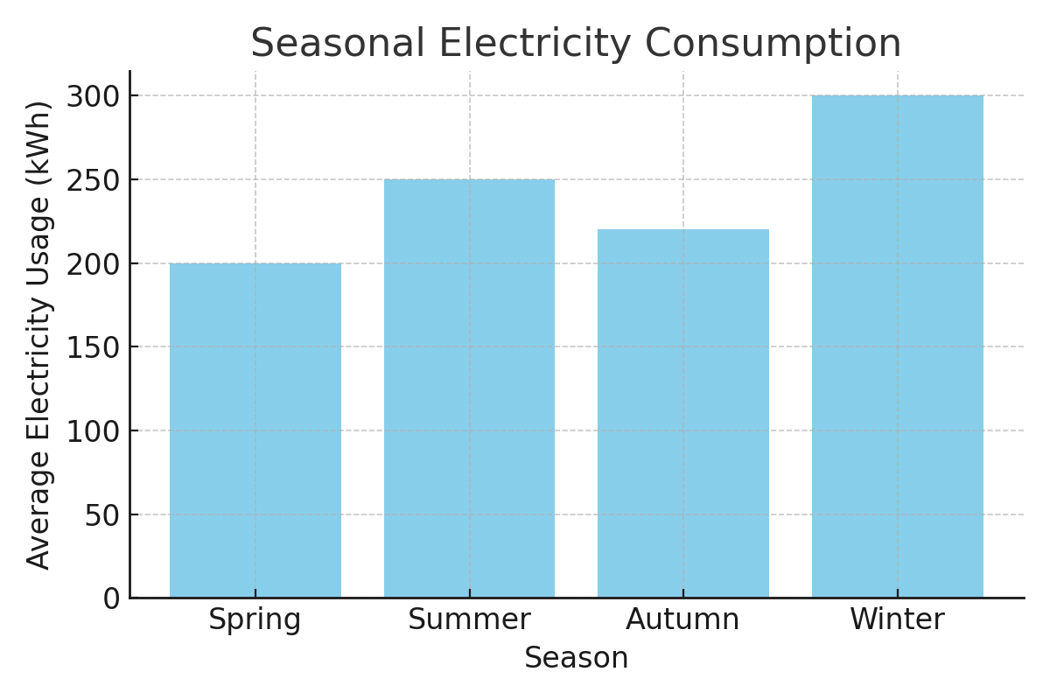
Why Predict Electricity Usage?
Electricity prices fluctuate: Costs are significantly higher during peak hours, typically in the evening.
Understanding peak times: Many households use more energy during peak hours, leading to higher bills.
Predicting usage: By analyzing data, we can identify when peak usage occurs.
Shifting energy-intensive tasks: Activities like laundry, dishwashing, and heating can be scheduled during off-peak hours (e.g., late night or early morning).
Benefits of optimization:
Cost savings: Reducing usage during peak hours can lead to lower electricity bills.
Energy efficiency: Helps in balancing demand and encourages sustainable energy consumption.
Project Goal:
To predict peak electricity usage periods in households using machine learning models, specifically Linear Regression and Random Forest Regression, based on historical electricity consumption data. By identifying these peak times, the project aims to help households adjust high-energy activities to off-peak hours, promoting cost savings and sustainable energy consumption across weekly, monthly, and yearly intervals.

Slide 3

Research Question
How can machine learning algorithms be effectively utilized to predict peak electricity usage in households based on historical data, and what strategies can be developed to optimize energy consumption during high usage periods?
Predicting Peak Usage:
Investigate how historical electricity consumption data can be analyzed using machine learning techniques.
Determine specific algorithms that can accurately identify peak usage times based on patterns in the data.
Optimizing Energy Consumption:
Explore practical strategies for households to reduce energy usage during identified peak times.
Suggest actionable recommendations for shifting energy-intensive tasks to off-peak hours, ultimately leading to cost savings.

Slide 4
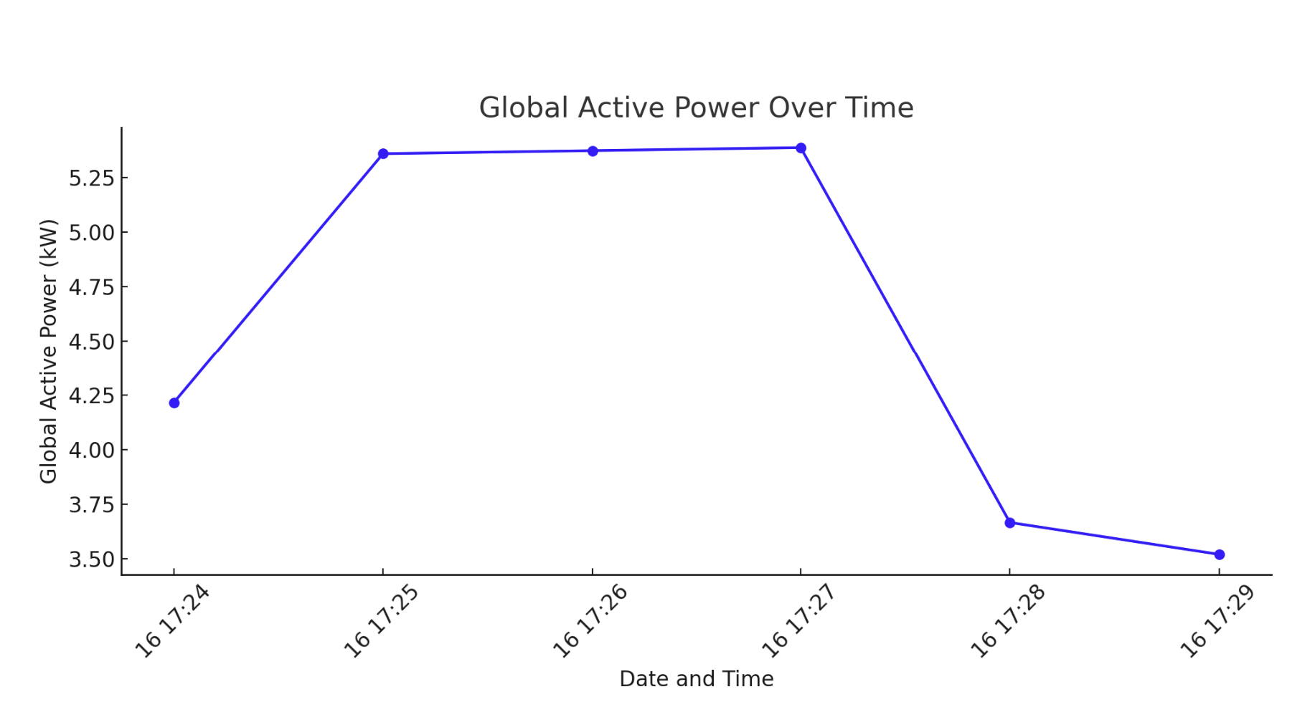
Dataset Overview
Dataset: Household Power Consumption
Source : UCI Machine Learning Repository
Description: This dataset contains minute-level measurements of electric power consumption in a single household in France over four years, from December 2006 to November 2010. It was collected using a smart meter, which records various aspects of electricity usage, providing detailed insights into household energy consumption patterns.
Key Features:
Date and Time: The dataset includes timestamps (date and time) for each measurement, allowing for time-series analysis.
Global Active Power (kWh): This represents the total active power consumed by the household, measured in kilowatt-hours. It indicates the energy usage during different times of the day.
Global Reactive Power (kWh): This indicates the reactive power in the system, which is used to maintain the voltage levels necessary for the system's operation.
Voltage (V): This shows the electrical potential in the system at any given time, measured in volts
Global Intensity (A): This measures the overall current intensity flowing through the household.
Sub-Metering Data:
Sub_metering_1: Energy consumption for kitchen appliances.
Sub_metering_2: Energy consumption for laundry appliances.
Sub_metering_3: Energy consumption for heating and cooling systems

Slide 5

Project Workflow
1. Data Preprocessing (Oct 16 – Oct 31)
Prepare and clean the data for modelling, by resample it to daily or hourly, and add useful features like time of day and season.
2. Exploratory Data Analysis (EDA) (Oct 16 – Oct 31)
Explore trends and patterns
3. Model Training (Nov 1 – Nov 15)
Build the prediction model using Linear Regression/Random Forest Regression
4. Model Evaluation (Nov 16 – Nov 22)
Assess model performance using error metrics(Mean Absolute Error (MAE), Root Mean Squared Error (RMSE))
5. Insights and Recommendations (Nov 23 – Nov 29)
Provide actionable strategies to optimize energy usage

Slide 6

Machine Learning Models:
Linear Regression:
Provides a simple, clear model to understand the linear relationship between time-based features (e.g., hour of the day, day of the week) and electricity usage.
Works well for identifying straightforward relationships between time and usage.
Random Forest Regression:
Captures complex, non-linear patterns across weekly, monthly, and yearly intervals in electricity usage, ideal for peak predictions.
More accurate for handling seasonal and daily fluctuations in energy consumption.
Using both models allows us to balance simplicity with accuracy, capturing both basic trends and complex patterns for reliable predictions.

Slide 7
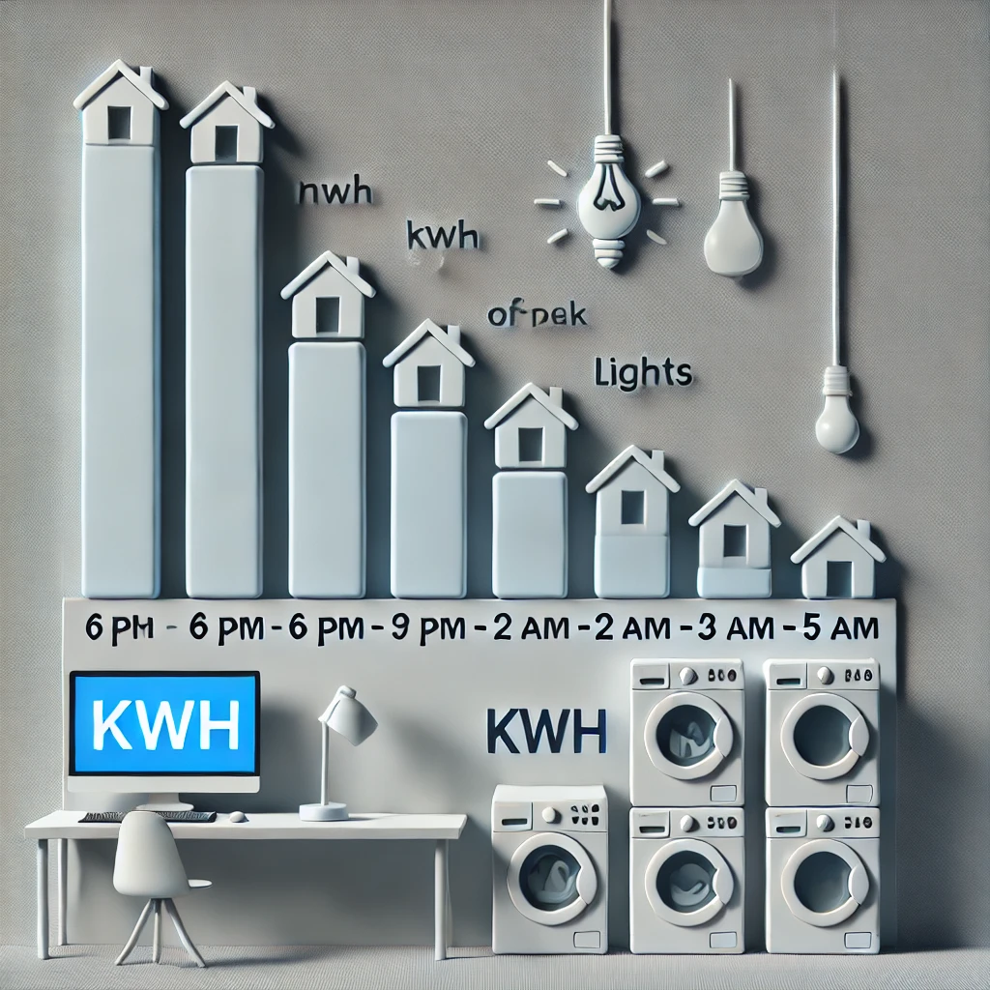
Key Insights & Recommendations
A simple scenario : By using the predictive model to shift laundry or dishwasher operations to non-peak hours, avoiding times of high electricity demand when rates are highest
Identified Peak Periods: Most energy usage happens in the mornings (6-9 AM) and evenings (6-9 PM) and Seasonality: Electricity usage spikes during winter months due to heating.
Recommendations: Shift high-energy tasks like laundry, dishwashing, and cooking to off-peak hours (e.g., late at night or mid-day) to save costs.
Potential Cost Savings: Households could reduce their electricity bills by up to 15% by avoiding peak usage times.

Slide 8

Ethical Considerations
Conclusion and Next Steps
Main Finding
Data Privacy: The dataset is fully anonymized, with no personal data included.
GDPR Compliance: The dataset is public and compliant with data protection regulations.
Ethical Use: The project adheres to ethical guidelines for data usage, aiming to benefit households without compromising privacy.
This project shows that predicting peak electricity usage with Linear Regression and Random Forest can help households reduce costs by shifting activities to off-peak times. Random Forest was especially effective for capturing complex usage patterns.
Future Work
Add real-time electricity pricing to increase savings.
Include more features, like weather, for better predictions.
Adapt the model for use across different households.
Develop an easy-to-use app to provide real-time usage alerts and recommendations.

